Slide 1
Unpaid Work, Gender and Education Inequalities: Profiles by Gender and Age in Selected African Countries
Reuben Mutegi
Moses Muriithi
Germano Mwabu
University of Nairobi

Slide 2
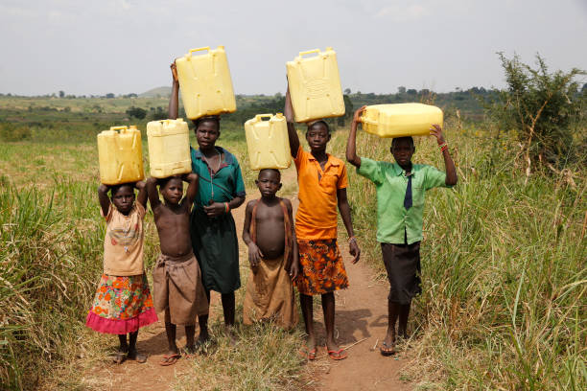
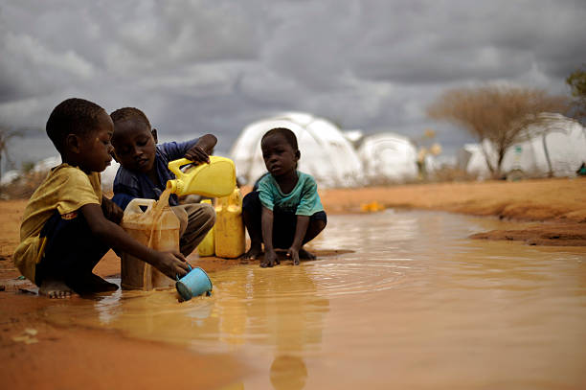
Cases of unpaid work
Children fetching water
Children fetching water

Slide 3
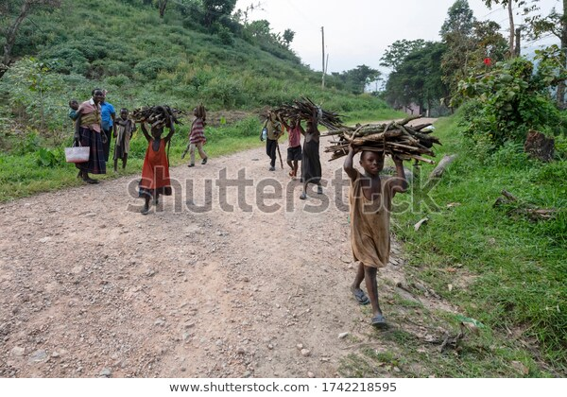
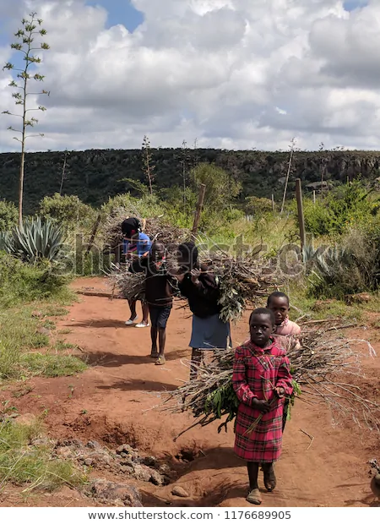
Children fetching firewood (Uganda)

Slide 4
Motivation
There have been concerns that child labour (paid work) minimizes learner participation in school
Consequently, studies were carried out to establish how child labour affects schooling (See Patrinos and Psacharopoulos (1997), Psacharopoulos (1997), Jensen and Skyt Nielsen (1997) and Ray (2000)
These studies focused more on child labour (paid work) and ignored unpaid work
This paper analyses the inequalities that exist in access to education due to Unpaid Work by gender and age of the learners in Selected African Countries

Slide 5
Research questions
Are there statistically significant differences in unpaid workers by gender among African countries?
Is unpaid work a source of gender inequality in education participation?
What policies can close the gender gap in unpaid work?

Slide 6
Methodology
To develop time use and inequality profiles we were guided by Reid (1934) and Donehower (2014) methodology which has the following steps
Identification of the time use survey
Identification of the unpaid activities not included in the GDP calculations
Imputation of monetary value to unpaid work activities
Estimation of the NTTA age profiles

Slide 7
Data
Country | Approximate sample size | Survey year
Ethiopia | 4000 | 2014
Tanzania | 3200 | 2011
Malawi | 3200 | 2013
Uganda | 3200 | 2011
The LSMS is a nationally representative data collected by National Statistics Offices of study countries.
The surveys have a time-use section that captures data on the number of hours spent by household members on some unpaid household work.
Since data on water and firewood collection was common across all study countries, we focused on the two variables for comparability purpose.

Slide 8
Results
Economic activities in Malawi

Slide 9
Economic activities by gender (Malawi)

Slide 10
Occupation by gender (Tanzania)

Slide 11
Hours of water and firewood by Gender and Age; Malawi

Slide 12
Hours of water and firewood Ethiopia

Slide 13
Hours of firewood and water (Uganda)

Slide 14
Hours of water and firewood (Tanzania)

Slide 15
Unpaid work as reason for not attending school.

Slide 16
Conclusion
This paper reveals a consistent evidence that African women spend much more time than men in search of water and firewood in all the countries studied
We find that affordable access to water and firewood is still a nightmare in many African countries in the 21st century
The findings further indicates that time is spent on water and firewood collection at the expense of schooling, especially among women.
We argue that reallocation or release of time spent on household chores for the market and schooling (currently in excess of 30 minutes) would significantly increase the wellbeing of households

Slide 17
Thank you

